Slide 1
Deep learning

Slide 2
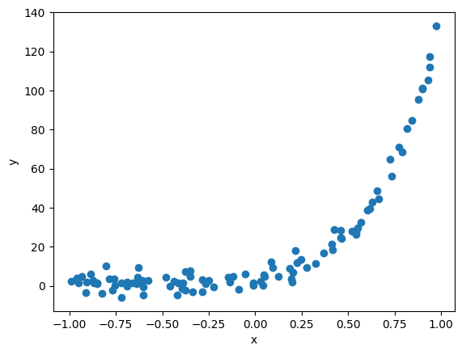
Modeling
Data
Objective function
Model
Optimization algorithm

Slide 3
Modeling
Data
(x, y)
Objective function
MSE
Model?
y = a + b * x?
y = a + b * x + c * x **2?
Optimization algorithm
SGD

Slide 4
Automatic diff

Slide 5
DL vs ML
Larger neural network
Requires
Data
Computational power
Training algorithms
Notes:
There is now a huge quantity of data available to train neural networks, and ANNs frequently outperform other ML techniques on very large and complex problems.
The tremendous increase in computing power since the 1990s now makes it possible to train large neural networks in a reasonable amount of time. This is in part due to Moore’s law (the number of components in integrated circuits has doubled about every 2 years over the last 50 years), but also thanks to the gaming industry, which has stimulated the production of powerful GPU cards by the millions. Moreover, cloud platforms have made this power accessible to everyone.
The training algorithms have been improved. To be fair they are only slightly different from the ones used in the 1990s, but these relatively small tweaks have had a huge positive impact.
Some theoretical limitations of ANNs have turned out to be benign in practice. For example, many people thought that ANN training algorithms were doomed because they were likely to get stuck in local optima, but it turns out that this is not a big problem in practice, especially for larger neural networks: the local optima often perform almost as well as the global optimum.
ANNs seem to have entered a virtuous circle of funding and progress. Amazing products based on ANNs regularly make the headline news, which pulls more and more attention and funding toward them, resulting in more and more progress and even more amazing products.

Slide 6
Applications
Image Segmentation
Classification
Translation
AlphaGo
Recommendation systems

Slide 7
In ML
Linear regression
y = b + w1 * x1 + w2 * x2 + …

Slide 8
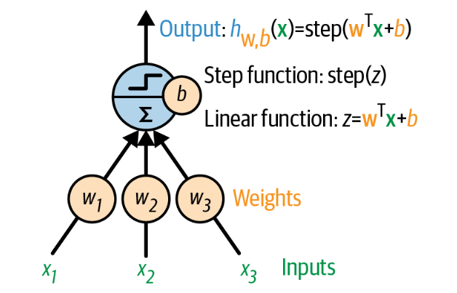
The Perceptron (neuron)

Slide 9
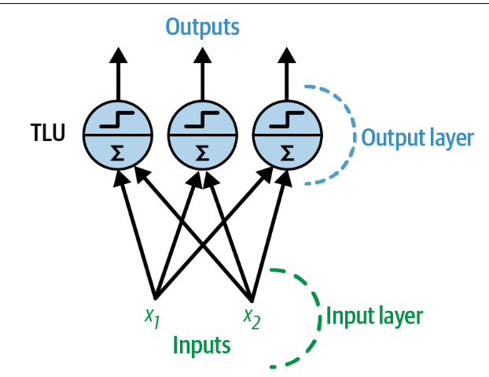
The Perceptron - multiple output neurons

Slide 10
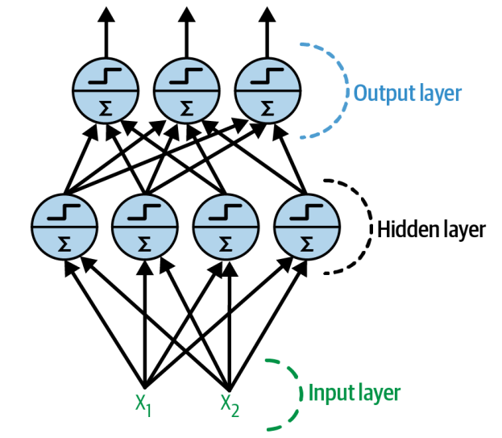
MLP

Slide 11
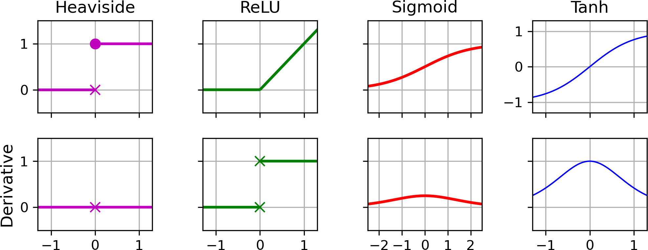
Activation functions
Hidden layers
Output layers

Slide 12
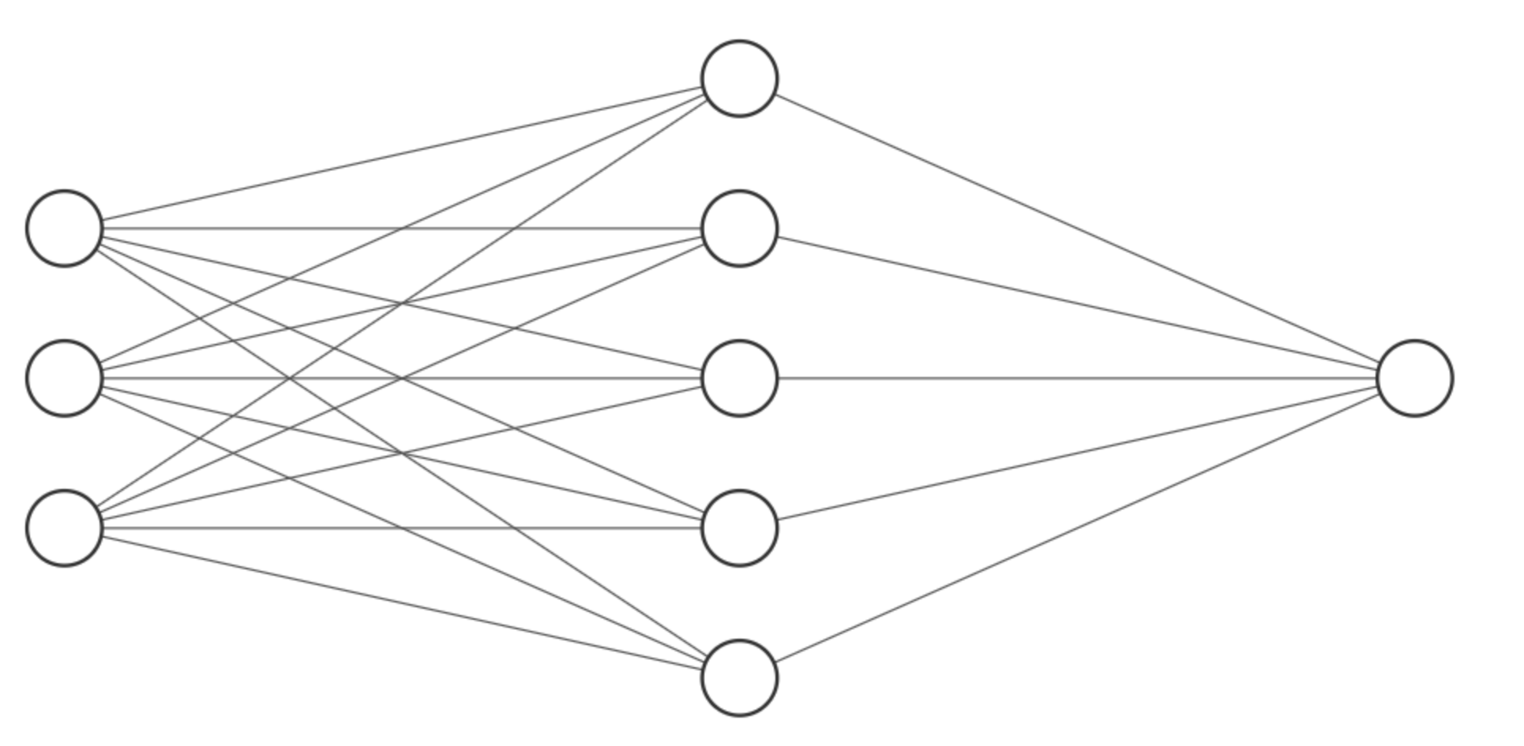
Optimization
Chain rule
Steps
Forward substitution
Calculate loss
Backprop
Parameters update
Input
Hidden
Output

Slide 13
Hyperparameters
Number of layers
Number of neurons
Learning rate
Batch size
Optimizer
Number of iterations

Slide 14
Vanishing/exploding gradients
Initialization
Activation functions
Batch normalization

